Slide 1

LaunchCode Liftoff
Class 5
Hank DeDona
8/30/2021

Slide 2
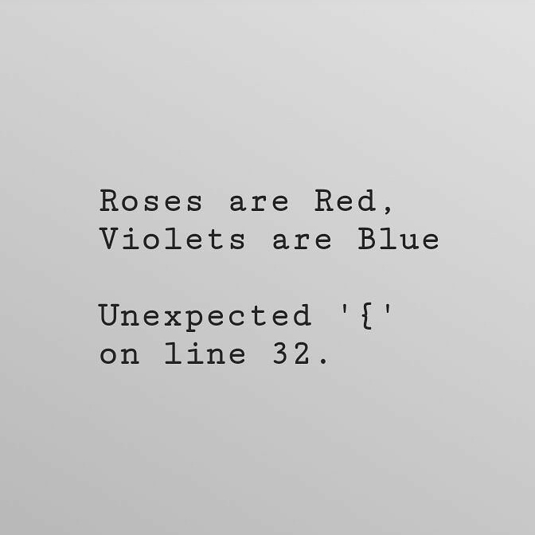
Agenda
Objectives and Timeline
Lecture:
Liftoff Completion Requirements
Additional fun topics ☺

Slide 3
Liftoff Project Timeline
Address Feedback
Next Features Behavioral Interview
Class 5
Class 7
Class 6
Class 8
Next Features
Final Review
Notes:
Resume Aug 21st

Slide 4
What does it take to finish Lift Off?
Mock Interview Module
Live Coding Module
LaunchCode Resume (Submitted via Canvas)
Final Project Review
LiftOff “Ready For Placement” Survey
Demographic Form (if not completed)
Notes:
Resume Aug 21st

Slide 5
LiftOff Fun Topics!
We decided to add a few fun topics of discussion tonight outside of the normal LiftOff curriculum ☺
Note: All these things are items that from one lecture you will not be proficient in. This is mainly to introduce you to other technologies for you to explore after graduating and could be something else you are interested in!
Notes:
Resume Aug 21st

Slide 6
Datastores (bases) SQL vs NoSQL
SQL databases are table-based, while NoSQL databases are document, key-value, graph, or wide-column stores.
SQL databases are better for multi-row transactions
NoSQL is better for unstructured data like documents or JSON
NoSQL has a dynamic schema vs SQLs static schema
NoSQL works best for companies that are going through rapid growth stages or those with a lot of unstructured data
Notes:
Resume Aug 21st

Slide 7
Datastores (bases) SQL vs NoSQL
SQL | NoSQL
MySQL | MongoDB
Oracle | CouchDB
Microsoft SQL Server
PostgresSQL
Notes:
Resume Aug 21st

Slide 8
DevOps
DevOps -> Development Operations; philosophies, practices, and tools that help to deliver software/services to users more efficiently.
Continuous Integration
Things such as Jenkins to build code developed by multiple concurrent engineers
Continuous Delivery
Automated code building, testing and preparing for release to production. Takes code from build -> deploy
Build Pipelines
Automated code jobs/stages, a typical pipeline would build, test, deploy to staging, then deploy to production. There are many types of pipelines, see: https://docs.gitlab.com/ee/ci/pipelines/
Monitoring and Logging
Things critical for high availability and troubleshooting; examples: Splunk, New Relic, etc.
Notes:
Resume Aug 21st

Slide 9
Deployments (rolling and blue/green)
We spent all of LC101 and Liftoff (thus far) teaching you how to code, but not how to deploy
The 2 primary types of deployments are in-place (or rolling) deployments and blue/green deployments. They both have their pros/cons
In-place (aka rolling) deployments go through each server node (or instance) in the cluster, remove it from the load balancer, shut down the web container/app, deploy the new code, restart the web container/app, and add it back into the load balancer.
Benefit of rolling deployments is that they require only one collection of nodes for each environment (dev/staging/prod)
Downfall of rolling deployments is rollbacks (going back to previous version of code) is difficult and requires doing another rolling deployment one server at a time.
Blue/Green deployments requires two collections of nodes for each environment, one called blue, and one called green. At any given time, only ONE collection (blue or green) is live in the environment. When it’s time to deploy new code, the new code is deployed to the collection that is not live. Once the deploy is complete, the load balancer is switched to the non-live environment.
Notes:
Resume Aug 21st

Slide 10
Deployments (rolling and blue/green) continued…
Blue/Green deployments requires two clusters of nodes for each environment, one called blue, and one called green.
At any given time, only ONE cluster (blue or green) is live in the environment.
When it’s time to deploy new code, the new code is deployed to the cluster that is not live. Once the deploy is complete, the load balancer is switched to the non-live cluster.
e.g. If we wanted to deploy code version 2.0 and green was live with code version 1.1 and blue was not live with version 1.0, we would deploy version 2.0 to blue and update the load balancer to make the blue collection live.
Benefit of blue/green deployments is the easy rollback if the updated code proves to be a failure.
The downfall is the necessity of multiple clusters, which costs $$$
Notes:
Resume Aug 21st

Slide 11
REST
REST – Representational State Transfer
Some interviewers will ask you to define REST, a lot of people fail on this, they can provide examples, but fail to explain what it is.
REST in its simplest form is a design paradigm for web services built on top of HTTP.
HTTP Verbs
GET
POST
PUT
DELETE
RESTful services should be client-server based stateless web services usually using JSON as the data type.
Notes:
Resume Aug 21st

Slide 12
Public Clouds
You’ve probably heard of them before, AWS, Azure, GCP, etc.
These are the public clouds many companies are using to run their businesses!
These public clouds provide many services at various layers including
IAAS – Infrastructure as a service – Basic building blocks of IT – Servers, network, data storage, etc.
PAAS – Platform as a service – Hardware and OS, allows for focus on deployment. No need to worry about OS level concerns (patches, etc)
SAAS – Software as a service – Completed product that can be run and is managed by the cloud provider. E.g. – Web-based email
The layer of public cloud services you use will depend on your needs, as you go from IAAS -> SAAS, your low-level control disappears.
https://aws.amazon.com/types-of-cloud-computing/
Notes:
Resume Aug 21st

Slide 13
Containerization
Back in the day, all web services were deployed to purchased, physical hardware as monolith servers/applications.
This was very expensive and left a lot of unused hardware as usually only 1 application was running per server.
Then we were introduced to virtual machines. This allowed us to split up a single server into multiple (virtual) servers, each with their own operating system and hardware resources
This was an improvement, but required each virtual machine to be updated
And lastly, we come to containers. Containers allowed multiple applications on a single machine with a single operating system (usually Linux :P)
Notes:
Resume Aug 21st

Slide 14
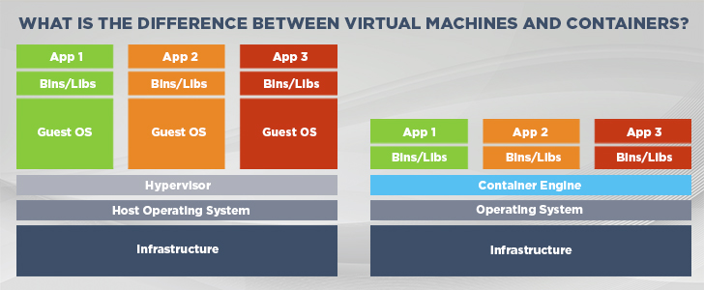
Containerization Vs VM
VM
Containers
Notes:
Resume Aug 21st

Slide 15
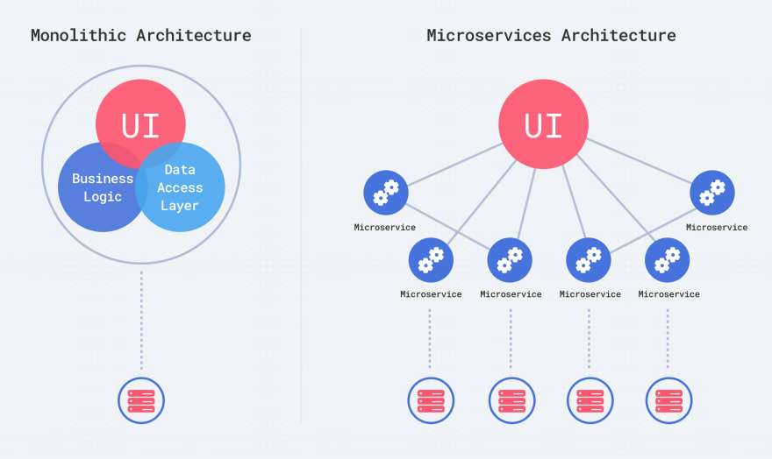
Microservices
Back in the day web services and applications were large, monolithic blobs.
With the introduction of containers, microservices started to emerge
Notes:
Resume Aug 21st

Slide 16
Microservices Vs Monolith
Microservices sound great but are not always the answer.
Microservices require more collaboration and well-defined contracts between microservices
Monitoring of the microservices is a MUST
Monoliths are usually easier to deploy (as there is just one), however, if there are well defined contracts that support BOTH backward and forward compatibility, microservices SHOULD be able to deployed on-demand at any time.
Notes:
Resume Aug 21st

Slide 17
Recap and Q&A
Tonight’s Objectives:
Have a high-level understanding of some topics not covered in LC101
Pique your interest ☺

